Slide 1

“GROCERY SHOP WEBSITE”
Website SRS

Slide 2
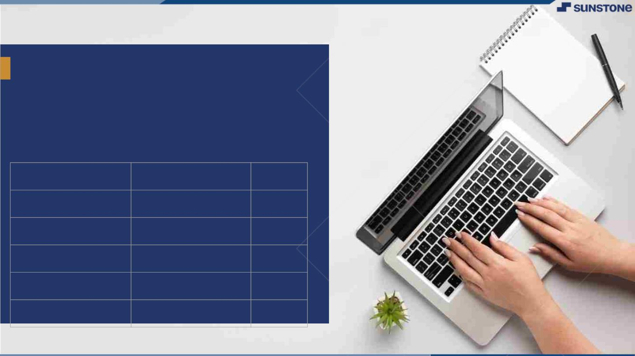
Grocery shop website:
▪
The main purpose of this document to define the software requirements for a grocery shop system.
This system will facilitate a management of inventory, customer,transactions and employee tasks in grocery store.
LMS Username
Name
Batch
K.Hariharasusdhan
11
D.Mahesh kumar
11
V.Ranjith
11
B.Saravanan
11
S.Vigneshwaran
11

Slide 3
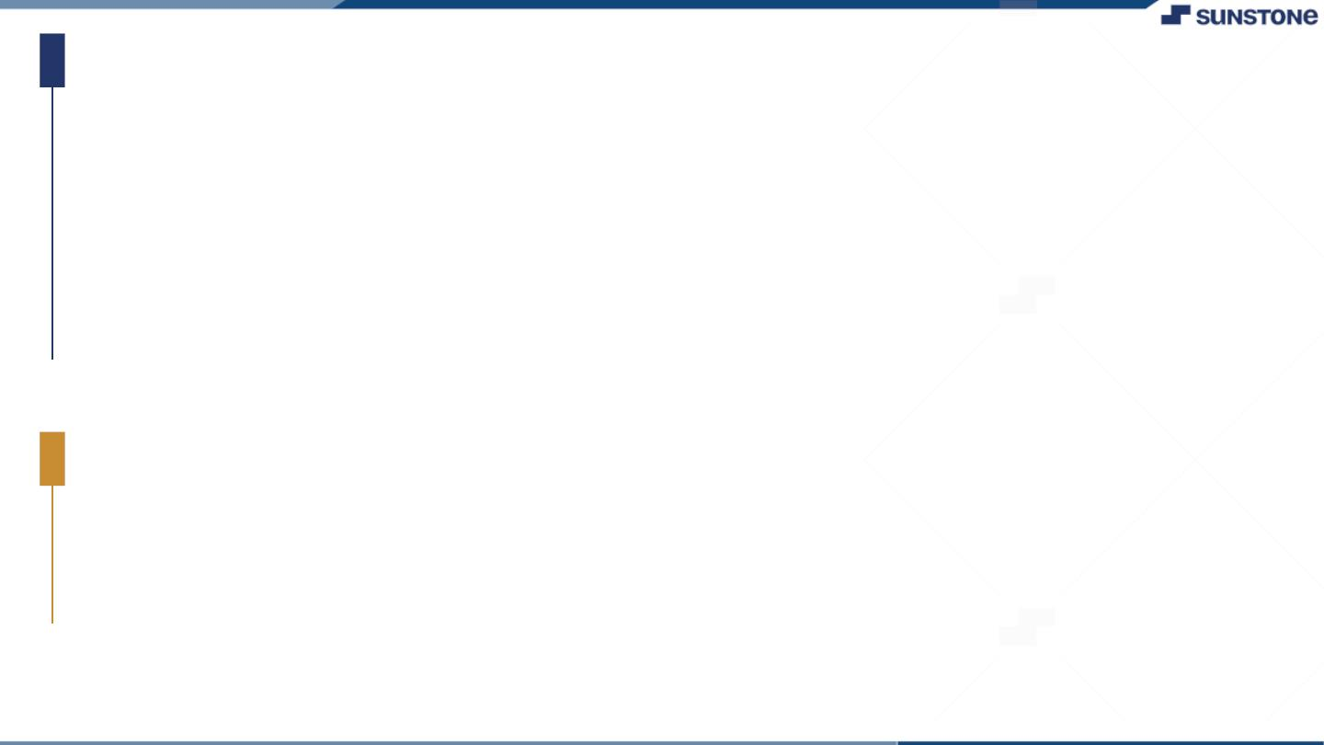
Taskꢀ-ꢀ1
CreationꢀofꢀSRSꢀ&ꢀGithub
▪
▪
▪
CreateꢀSRSꢀ:ꢀ“Grocery shop website”
Creationꢀ&ꢀSet-upꢀofꢀGithubꢀaccount
Creationꢀ&ꢀHands-onꢀtoꢀvariousꢀcommandsꢀofꢀGitꢀBash
EvaluationꢀMetric:
● 100%ꢀCompletionꢀofꢀtheꢀaboveꢀtasks
Learning Outcome
▪
▪
▪
▪
Getꢀtoꢀknowꢀaboutꢀdifferentꢀlifecycleꢀmodels.
UnderstandingꢀimportanceꢀandꢀhowꢀtoꢀcreateꢀanꢀSRS
KnowingꢀvariousꢀcommandsꢀofꢀGithub
Understandingꢀagileꢀandꢀscrumꢀmanagementꢀtechniquesꢀforꢀefficientꢀproductꢀdevelopment

Slide 4
Step-WiseꢀDescription
Inventory Tracking System: Implement an inventory tracking system, such as inventory management software or an e-commerce platform with inventory management features. This system should help you keep track of your products, their quantities, and their status (in stock, out of stock, etc.).
Categorize Your Products: Group your grocery items into categories like fresh produce, dairy, meat, canned goods, etc. This helps you organize your inventory and makes it easier for customers to find products.
Set Par Levels: Determine the minimum and maximum stock levels for each product. When the stock falls below the minimum level, it should trigger a reorder.
Replenishment System: Implement a system that automatically reorders products when they reach the minimum stock level. This can be integrated with your suppliers or wholesalers.
Supplier Relationships: Establish strong relationships with your suppliers. Communicate your inventory needs, lead times, and quality expectations. Reliable suppliers are crucial to maintaining a well-stocked inventory.

Slide 5
A Grocery shop plays a fundamental role in providing essential food and household items to the community.
Real-time Inventory Updates: Ensure your inventory system provides real-time updates on product availability. Customers should see accurate stock levels on your website to prevent over-selling.
Batch and Expiry Tracking: Especially important for perishable items, track the batch and expiry dates of products. This helps prevent selling expired or spoiled goods.
First-In, First-Out (FIFO): Implement a FIFO system to ensure older products are sold first. This minimizes waste and helps maintain product freshness.
Summaryꢀof ourꢀtask
The success of a grocery shop relies on effective inventory management,quality products,competitive pricing,and excellent customer service.

Slide 6
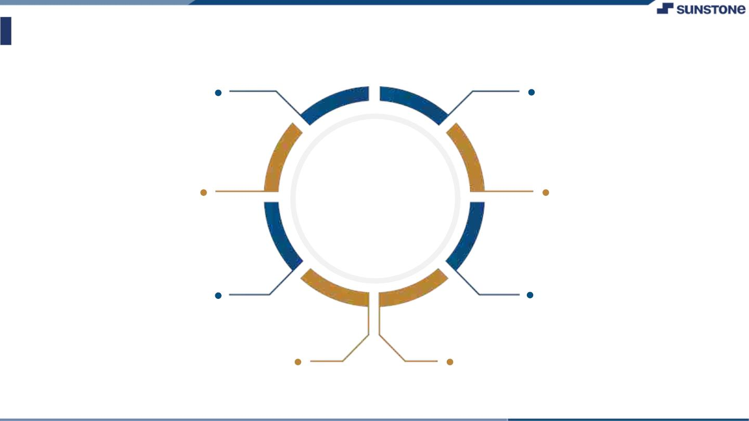
AssessmentꢀParameter
Gatherꢀrequirementsꢀforꢀtheꢀ
project
addꢀReadme.mdꢀfileꢀwithꢀ
descriptionꢀofꢀtheꢀproject
Prepareꢀdatabaseꢀdesignꢀ
schemas
Check-List
Commitꢀallꢀchangesꢀwithꢀ"firstꢀ
commit"
Getꢀyourꢀinitialꢀprojectꢀ
Structureꢀready
createꢀaꢀrepositoryꢀonꢀgithubꢀ
realtedꢀtoꢀproject
Initiateꢀaꢀgitꢀrepository
Pushꢀyourꢀchangesꢀtoꢀgithub

Slide 7
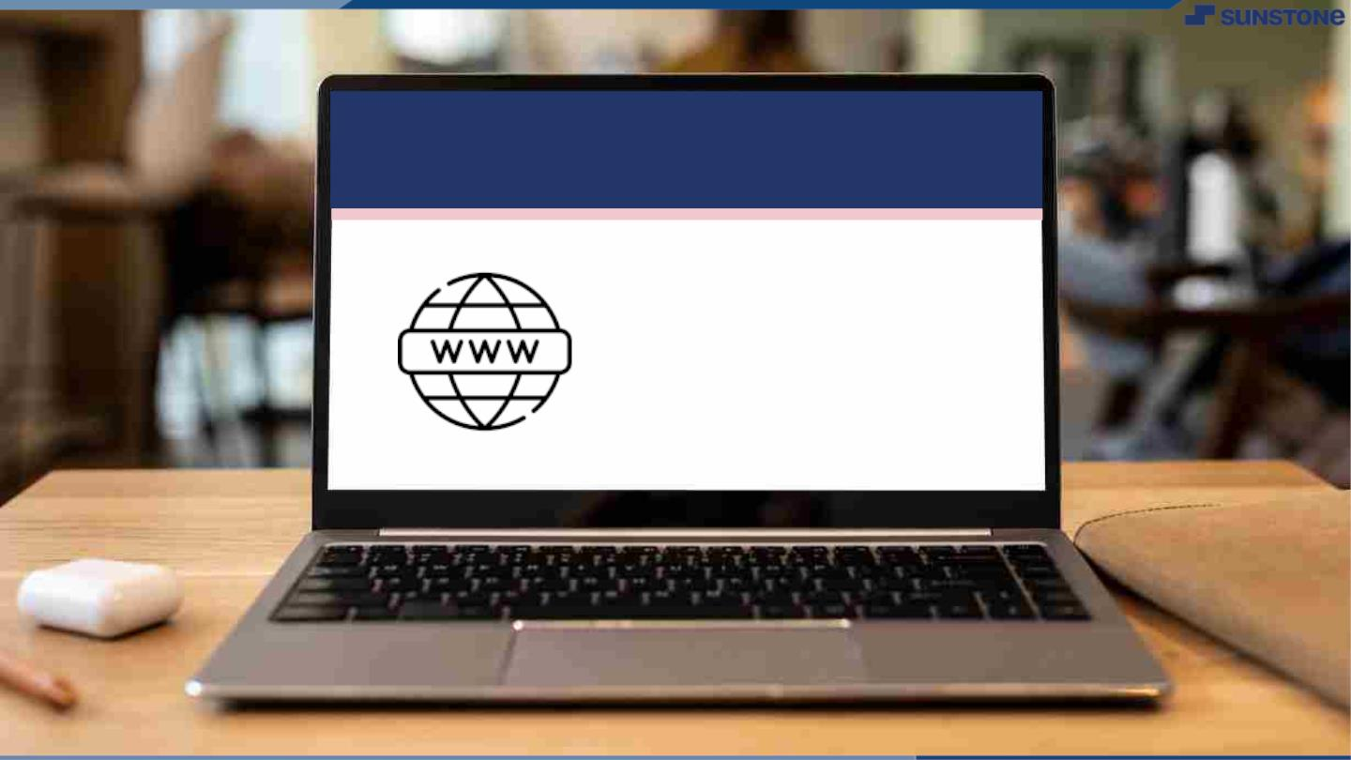
Submission Github
https://github.com/demonsaravanan/naan-mudhalvan

Slide 8


